Slide 1
Behavior-Based Safety Observations
BBSO Overview
Learn more at:
weeverapps.com/BBSO

Slide 2
What are they?
BBSO Overview
Behavior-Based Safety Observations (BBSO) are an integral part of modern, proactive safety programs.
The goal is to reduce the number of incidents by recognizing safe behavior and eliminating unsafe practices either through training or updates to Standard Operating Procedures (SOPs).
The BBSO practice has gained popularity because it is relatively easy to implement and manage, it fosters a safety-first culture and it delivers results.

Slide 3
Why are they important?
BBSO Overview
Help to foster a “Safety First” culture by keeping safety “top-of-mind” and continuously reinforcing best practices.
BBSO programs are a low cost and relatively simple way to enhance safety quickly and drive real results.
Reduce costs and problems associated to safety issues.
Provide insights to understand training gaps and in-person instruction.

Slide 4
How do BBSO Programs Work?
How do they work?
BBSO programs require observations from staff, evaluation by supervisors and KPI reporting to measure results.
Safety Observations - Mandatory data capture
Evaluation & Action - Evaluate Submissions and Create Action Plans
Showcase Results - Broadcast KPI improvements

Slide 5
Step 1: Safety Observations
How do they work?
Safety Managers provide a bit of training around what to observe, when, and how often.
Observers need to inform the observed staff members that they are being watched.
Staff mark certain elements as “Safe” or “At Risk”:
Body Position - Posture, Fall Risk, Line of Fire, Twisting, etc.
PPE - Eyes and Face, Respiratory System, Hand Protection, etc.
Tools & Equipment - Correct Use, Condition, etc.
Work Environment - Housekeeping, Hazards, Area Organization, etc.
Procedures - LOTO Not Posted, Training, etc.

Slide 6
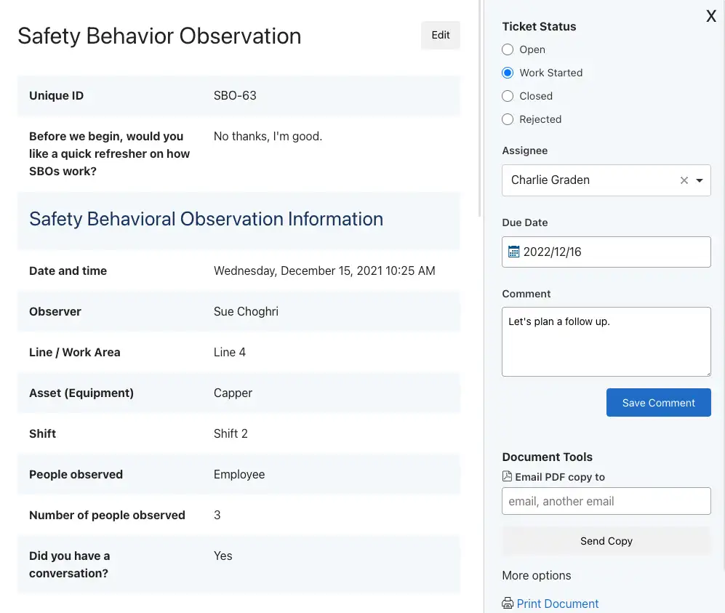
Step 2: Evaluation & Action
How do they work?
When observations are submitted, Supervisors review them and create action plans.
Any behaviors that present an immediate danger to the life and health of the worker, or to the environment, must be stopped immediately and a discussion between the observer and the worker regarding the matter should take place.
At risk behaviours can create a few different action plans:
Review best practices with observer and/or observed - Plan a follow up to review appropriate behaviors.
Create Learning Content - Safety Managers can create a One Point Lesson or “Toolbox Talk” session where all staff will review the best practice and sign off that they understand.
Update SOP - In some cases, BBSOs reveal a need to update Safety Standard Operating Procedures.

Slide 7
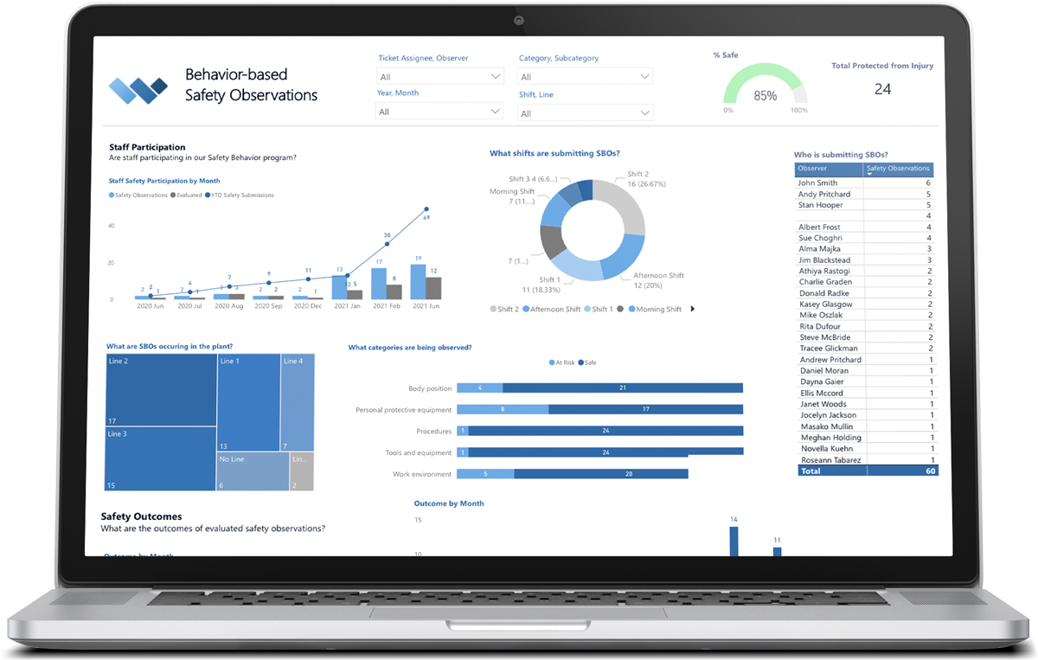
Step 3: Showcase Results
How do they work?
The magic of BBSO programs comes in the feedback to staff that shows that the site is safer as a result of their work.
Usually, Safety Managers can point to safety KPIs, such as near misses or incidents to show that the BBSO program is having a positive impact.

Slide 8
Why Digitize BBSO?
Software provides a ton of benefits over a paper based program. Here is a run down of how Weever works to automate data capture, workflows and real-time reporting.
Provide on-demand instructions
Guide staff through the experience
Create Schedules
Capture Data on any device
Configurable Templates
Automate Rewards
Add Photos
Enable Real-time Communication
Accelerate the Evaluation Process
Assign Next Steps and Due Dates
Automate Real-Time Dashboard Updates
Broadcast Results
Digital Solution

Slide 9
Behavior-Based Safety Observations
BBSO Overview
Learn more at:
weeverapps.com/BBSO

